Slide 1

xTuple PostBooks Edition
A Presentation by:
Liliya Artyukh
Rodrigo Domiciano de Almeida
Lesley-Ann Comissiong
Kathleen Wilson

Slide 2
xTuple PostBooks Edition
PostBooks® is a full-featured, fully-integrated business management system that includes
Accounting
CRM
Sales
Purchasing
Manufacturing
Asset Management

Slide 3
xTuple Overview
Uses open source technologies
Fully flexible and scalable
Platform independent
Fully internationalized with support for
Multiple tax structures
Different currencies
Multilingual translation packs
Can be deployed locally or accessed through the Cloud

Slide 4
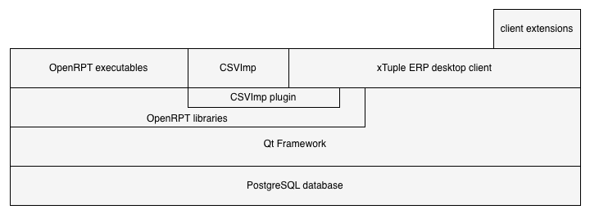
xTuple Desktop Architecture

Slide 5
xTuple Architecture Technologies
C++ with the Qt framework for the client
OpenRPT: a free, open source report writer
CSVImp: a free, open source tool for importing data
PostgreSQL database server
Updater: a free, open source tool for upgrading databases and loading extension packages
Extension packages written primarily in JavaScript

Slide 6
xTuple Activities
Creating a sales order
Tracking time & expense
Creating an account incident

Slide 7
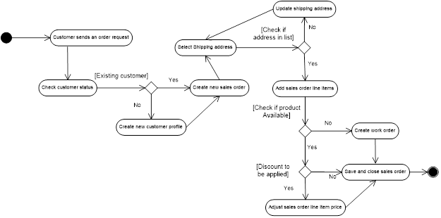
Creating a sales order

Slide 8
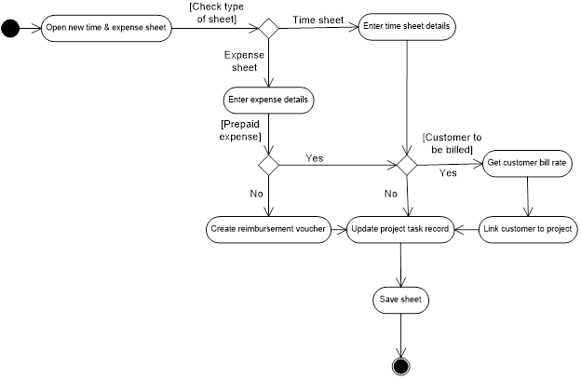
Tracking time & expense

Slide 9
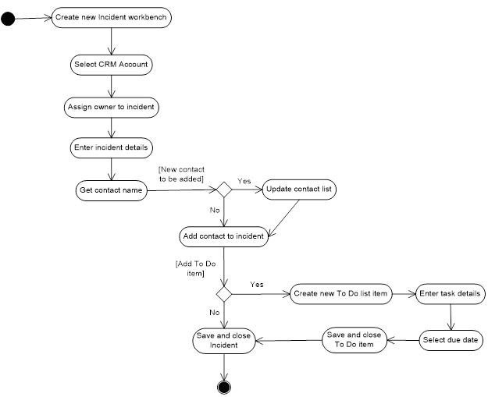
Creating an account incident

Slide 10
Use Case

Slide 11
Capabilities
Collection of various data: personal information, complaints, to do list, etc…
Reporting to help sales representative to understand data and build strategy
Create personalized marketing
Cloud Portability
Strong Flexibility - highly configurable

Slide 12
Benefits
Convenient – everything in one place, also it is available online
Saves time – reporting organizes data in different ways, automated emails
Sales improvements – getting more customers, customizing communication
Customer satisfaction – the more the company knows about the customer the better it can serve that customer

Slide 13
Customization & Integration
Types of Customization:
Custom development by the source code available on SourceForge
Assisted by xTuple’s Developer Team
Integration:
Supported by Windows, Linux and Mac because it uses open source technologies
Mobile web client that uses HTML5
Does not have integration with social media plugins or office applications

Slide 14
Additional CRM Applications
Salesforce.com
Microsoft Dynamics CRM
Zoho
SugarCRM
Maximizer CRM

Slide 15
Main Transactions Demo

Slide 16
Thanks!

